Slide 1
Operation Hexfall

Slide 2



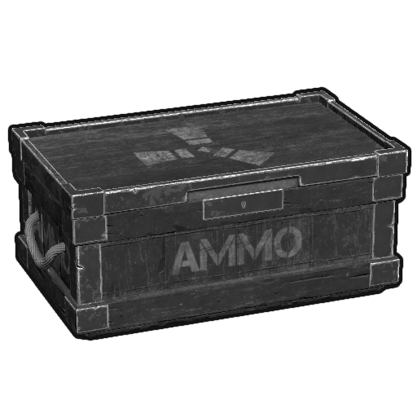

Mission
Hexfall was brought to the the government’s attention after they opened an online weapons marketplace running on the darknet.
It is believed they have two crates of weapons onsite as well as the hardware to run their own online weapons marketplace.
You must take down the online weapon marketplace and take control of both weapons crates.

Slide 3


Mission
Intel indicates that Hexfall's lead hacker has a flash drive where he stores the passwords to all their computers.
You must obtain the flash drive, get the passwords, login to the remote server, and takedown the website.
Your mission is complete when you take down the Hexfall website and take control of both weapons crates.
passwords
:~$ ssh

Slide 4
Rules of Engagement
Do not shoot nerf guns in hallway
Any friendly casualties must be brought back to home base for medical care
You have 7 minutes to plan and 30 minutes to execute

Slide 5


Intel
Intel report of Hexfall Website located at http://oqhvavolpkp6vh2cywgg4kuxf2rvv3djbuxmcwfcsonbcy3zwldxw4id.onion
Intel report of Hexfall HQ located at Room A310

